Slide 1
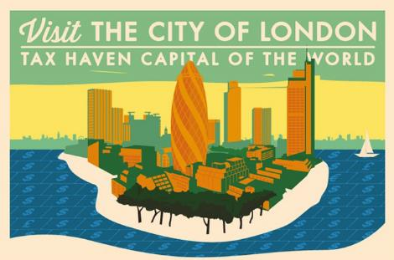

BREXIT AND THE FUTURE OF TAX HAVENS
The Impact of Brexit on Tax Evasion
and Money Laundering
22nd January 2019
John Christensen
Notes:
1

Slide 2

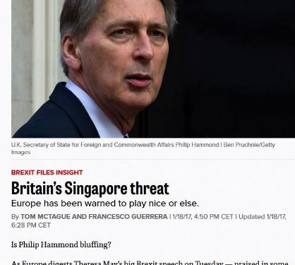

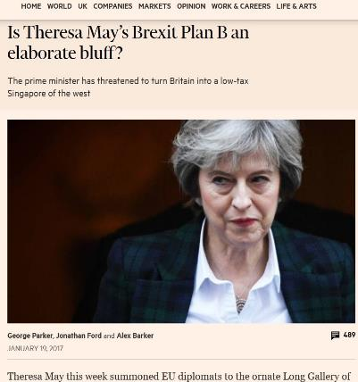

Slide 3
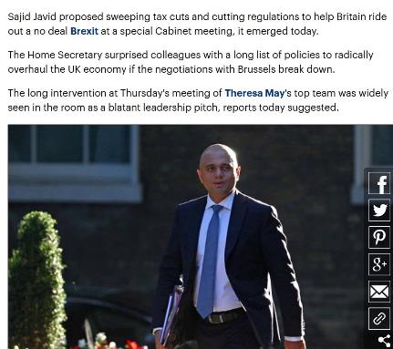
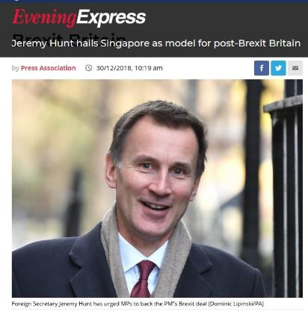

Slide 4
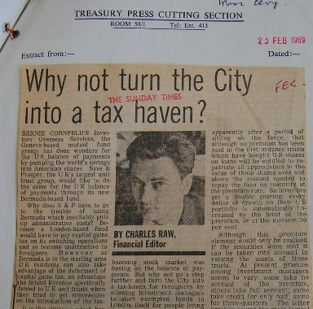
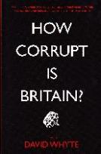
Steadily, stealthily, the British tax system and broader economy has been reconfigured since the 1950s to serve the interests of a class of unaccountable, untouchable offshore-diving super-rich . . swathes of the British political class are deeply embedded in offshore secrecy . . .
Christensen, J. ‘On Her Majesty’s Secrecy Service’ in Whyte, D. (2015) How Corrupt is Britain?
“
”

Slide 5
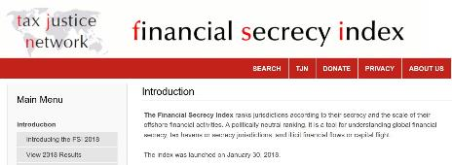
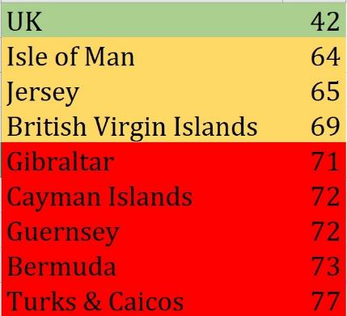
Combined global market share of Britain’s tax haven empire based on IMF data on cross-border shares of offshore financial services
provided to non-residents is approximately 23 percent
the weakest
Secrecy score within Britain’s Spider’s Web (2018 FSI)

Slide 6

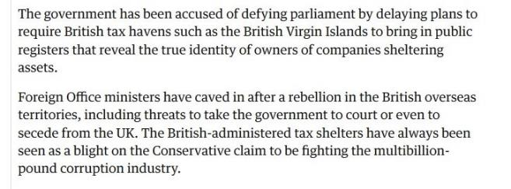
“At the same time (1831), the slaves were aware of the growing abolitionist movement in England. They were even more aware of the planters’ response to it . . . threats of armed revolt and secession . . . There was even talk of a massacre of male slaves.”
The Blood Never Dried, John Newsinger (2013)

Slide 7
Equivalence
Equivalence is a relatively new legal concept which facilitates cross border trading between states that choose to recognise one another’s standards.
It does not, however, require both sides to harmonise on rules and legislation.
EU legislation allows for revocation of a declaration of equivalence on 30 days notice.
To protect itself from potential risks of deregulation and weak compliance, the EU needs to arrive at a detailed agreement on definitions, rules, legislation, and regulatory standards before even considering an offer of equivalent treatment

Slide 8

@jechristensen56
wwwtaxjustice.net
john@taxjustice.net

