Slide 1


The UK revenue potential of curbing multinational tax avoidance
Estimated returns to transparency:
public country-by-country reporting
Alex Cobham @alexcobham
October 2018

Slide 2
“TJN has done more than any other organisation to put fiscal justice at the center of the policy agenda.
Tax issues should not be left to
those who want to escape taxes!
Changes will come when more and more citizens of the world take ownership of these matters. TJN is a powerful force acting in this direction.”
Thomas Piketty

Slide 3
Overview
Public country-by-country reporting: a tax accountability tool
The scale of multinational tax avoidance in the UK
  Katarina Habu, Oxford University, 2017
The returns to public country-by-country reporting
  Michael Overesch & Hubertus Wolff, U. Cologne, 2018
Combining results to estimate UK revenue potential

Slide 4
1. Public country-by-country reporting by multinationals
Concept
Policy progress
UK opportunity

Slide 5
Original concept
Multinationals required to publish, for each jurisdiction:
  List of all entities
  Scale of economic activity (e.g. sales, employment, assets)
  Taxable profits and tax paid
Notes:
Full details in Cobham, Gray and Murphy, 2017, ‘What Do They Pay?
Towards a Public Database to Account for the Economic Activities and Tax Contributions of Multinational Corporations’, Open Data for Tax Justice: http://datafortaxjustice.net/what-do-they-pay/.

Slide 6
Policy progress
Roots in early concerns about accountability of multinational companies
Draft accounting standard (Murphy, 2003) published by AABA/Tax Justice Network
OECD standard finalised in 2015, for private reporting to tax authorities
Next step: public reporting

Slide 7
UK opportunity
‘Flint amendment’ to 2016 Finance Bill gave UK Treasury the power to require publication of OECD standard country-by-country reporting
  Near-zero compliance costs (data prepared already)
  Potential for significant benefits
  UK government had argued for joint EU publication, but now no longer viable for UK to influence EU
Notes:
Full details in Cobham, Gray and Murphy, 2017, ‘What Do They Pay?
Towards a Public Database to Account for the Economic Activities and Tax Contributions of Multinational Corporations’, Open Data for Tax Justice: http://datafortaxjustice.net/what-do-they-pay/.

Slide 8
UK opportunity (2)
Potential benefits to public reporting
  Revenue
    Reduced tax avoidance by multinationals
  Fairer competition
    Closing gap between multinationals and domestic firms
  Tax morale
    Transparency of multinationals supporting their compliance, and also strengthening compliance throughout economy as other taxpayers gain confidence
Notes:
Full details in Cobham, Gray and Murphy, 2017, ‘What Do They Pay?
Towards a Public Database to Account for the Economic Activities and Tax Contributions of Multinational Corporations’, Open Data for Tax Justice: http://datafortaxjustice.net/what-do-they-pay/.

Slide 9
2. The scale of multinational tax avoidance in the UK
Data
Approach
Key results

Slide 10
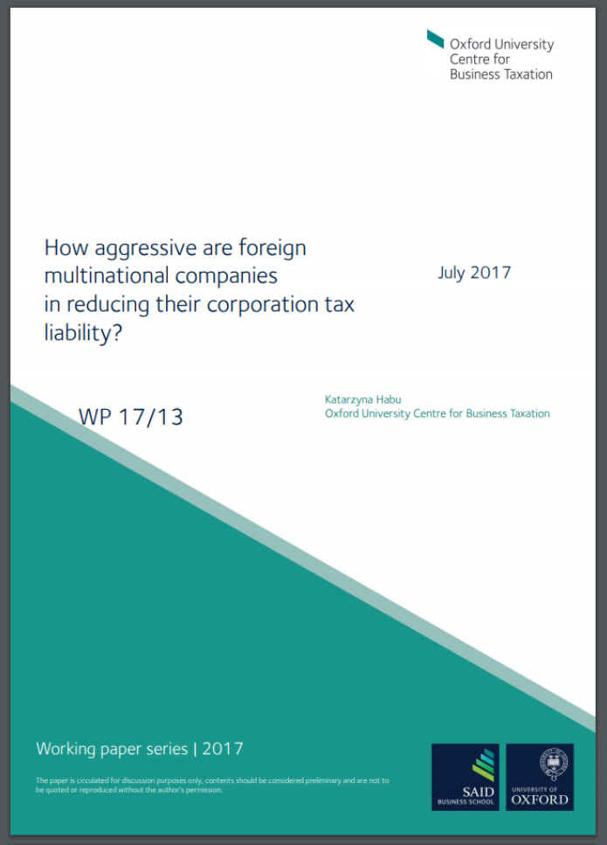
Scale of avoidance: Habu (2017)
Data
  First study with access to HMRC confidential tax returns (2000-2011) – all firms, CT600 form
  Merged with accounting (balance sheet) data from FAME, including total assets
Notes:
Habu, K., 2017, ‘How aggressive are foreign multinational companies in reducing their corporation tax liability?’, Oxford University Centre for Business Taxation working paper WP 17/13: http://eureka.sbs.ox.ac.uk/6810/1/WP1713.pdf.

Slide 11
Scale of avoidance: Habu (2017)
Approach
  Propensity score matching, to allow for differences in observable firm characteristics e.g. size, industry
  Second stage: estimate differences in ratio of taxable profits to total assets, for domestic standalone firms vs foreign multinationals’ subsidiaries
  NB. Likely understates scale because largest foreign multinationals excluded (no domestic of same size)

Slide 12
Scale of avoidance: Habu (2017)
Results (1)
  Difference between domestic standalones and foreign multinational subsidiaries is estimated to be 12.76 percentage points for ratio of taxable profits to total assets
  Mean ratio is 12.41% vs 25.17%: foreign multinational subsidiaries underreport their taxable profits by about 50% relative to domestic standalones

Slide 13
Scale of avoidance: Habu (2017)
Results (2)
  Gap in ratio of taxable profits to total assets varies between 30 and 70 per cent. Equalizing tax payments of foreign multinational subsidiaries and domestic standalones would generate
  c.£3 billion in 2000 (10 per cent of CIT revenues)
  rising to
  c.£25 billion in 2011 (70 per cent of CIT revenues).

Slide 14
3. The impact of public country-by-country data
Data
Approach
Key results

Slide 15
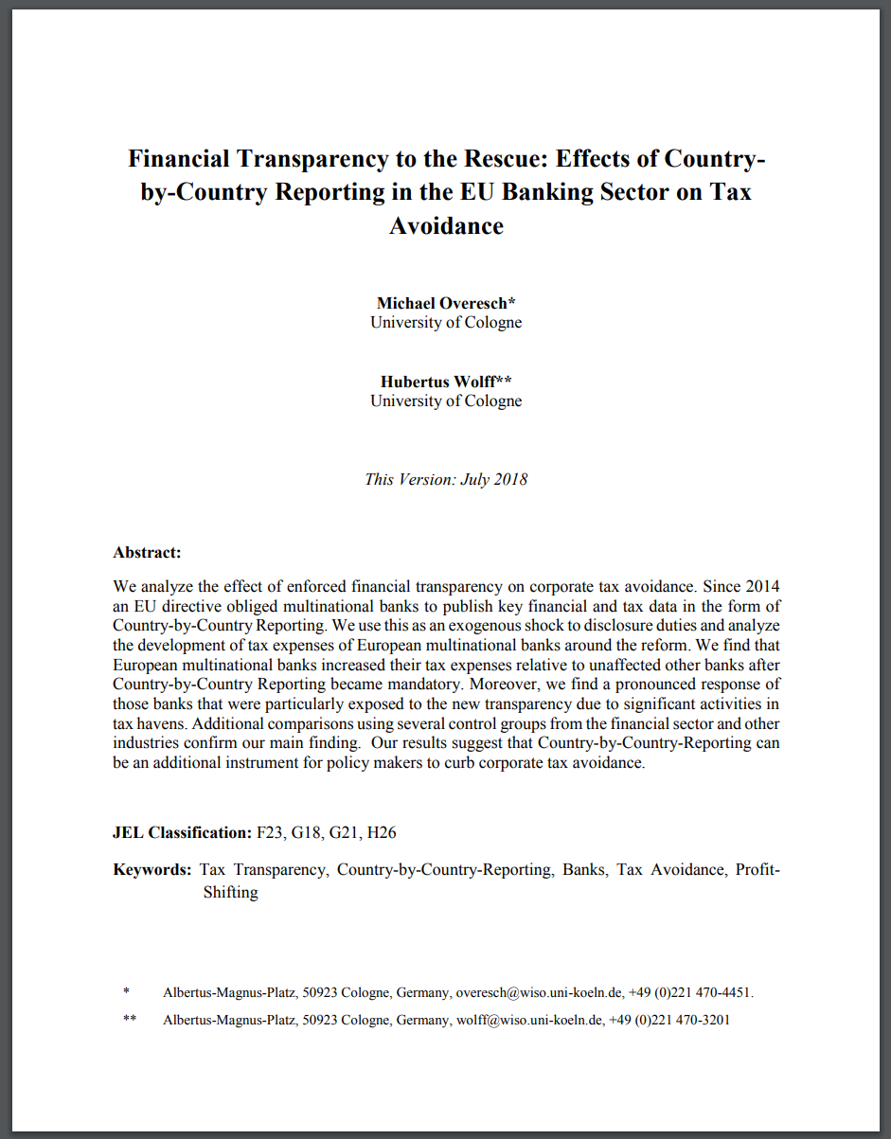
Impact of transparency: O&W (20188)
Data
  Consolidated financial info on 207 banks with EEA HQs,2010-2016 (Compustat), US banks (Fed data)
  Regional activity data (Bankscope)
  Plus whether subject to EU’s CRD IV public country-by-country reporting requirement
Notes:
Overesch, Michael and Wolff, Hubertus, Does Country-by-Country Reporting Alleviate Corporate Tax Avoidance? Evidence from the European Banking Sector (July 2018). Available at SSRN: https://ssrn.com/abstract=3075784 or http://dx.doi.org/10.2139/ssrn.3075784

Slide 16
Impact of transparency: O&W (20188)
Approach
  Propensity score matching, to allow for differences in observable bank characteristics e.g. size, profitability
  Second stage: estimate differences in effective tax rate (ETR) between European multinational banks subject to CRD IV, vs domestic standalones / US multinational banks / other EU industries

Slide 17
Impact of transparency: O&W (20188)
Results (1)
  Point estimate: banks subject to public country-by-country reporting saw average increase in effective tax levels of 2.5 percentage points relative to unaffected banks
  “This finding implies, that multinational banks paid substantially more taxes than their domestic peers after the reform. Taking an average ETR of 23 percent, the magnitude of the coefficient suggests that the overall tax expenditure of an affected banking group increased by approximately one tenth in total through CbCR”

Slide 18
Impact of transparency: O&W (20188)
Results (2)
  EU banks with ‘tax haven’ activity react more strongly to forced transparency of country-by-country reporting (while banks that do not have such behaviour to reveal, do not need to adjust)
  These banks increased their ETR by 3.7 percentage points relative to all other multinational banks over the period.

Slide 19
4. UK revenue potential

Slide 20
Additional data
Ratio of taxable profit to total assets
  Q: has OECD BEPS project (2013-15) changed profit suppression found by Habu in period up to 2011?

Slide 21
Profitability of US multinationals
Notes:
Source: TJN calculations on Data on activities of multinational enterprises: U.S. Direct Investment Abroad, from US Bureau of Economic Analysis (downloaded Sep.18).

Slide 22
Conservative assumptions
Hold estimated revenue loss constant in nominal terms from 2011 estimate of £25bn (despite evidence of US multinationals’ continuing behaviour)
Take OECD country-by-country to be no more effective than CRD IV (despite stronger standard, coverage)
Treat ETR change as equivalent to reduction in profit under-declaration (Habu finds accounting profit approaches likely to understate issue substantially)
Assume UK change is proportion to global ETR change (UK big loser to profit shifting, so gain should be disproportionate)
Use average ETR effect, not larger ‘multinationals with tax haven activity’ effect

Slide 23
Base case revenue estimate
O&W (2018): ‘overall tax expenditure of an affected banking group increased by approximately one tenth’ after transparency
Habu (2017): foreign multinationals’ subsidiaries reporting c.50% less profit than domestic standalones, costing £25bn
Increase profit reporting (and thus tax expenditures) by a tenth => c.45% less than domestic
Revenue loss to foreign multinational tax avoidance falls by c.£2.5bn per year

Slide 24
Complications
Profit declaration non-convex (Habu) => two firm types:
  Revealing zero profit declaration despite large activity is not sufficiently embarrassing/brand-threatening to change decision, so no impact
  Revealing zero profit declaration despite large activity is sufficiently embarrassing/brand-threatening to change decision. Habu (2017) finds that foreign subs reporting (non-zero) profit behave similarly to domestic standalones, so impact could be much larger (i.e. from total avoidance, to domestic standalone behaviour)
Combination of the two types will determine revenue scale

Slide 25
Wider benefits: Beyond revenue
Fairer competition
  With no additional compliance costs, making OECD standard country-by-country reporting data public will reduce the unfair tax advantage that the tax system currently gives foreign multinationals over purely domestic businesses
Stronger tax morale
  Transparency about (greater) compliance by big taxpayers will strengthen tax morale and hence compliance throughout economy
International leadership
  Public country-by-country reporting is on the EU agenda, and the subject of various new initiatives. UK can be the first mover
Legislation has already passed
  The Flint amendment to the 2016 Finance Bill, as agreed by government, gave Treasury the power to require this data two years ago. It’s past time!

Slide 26
The UK revenue potential of curbing multinational tax avoidance
Estimated returns to transparency:
public country-by-country reporting
Alex Cobham @alexcobham
October 2018

