Slide 1




How can we avoid
another crisis?

Slide 2


How can we avoid another crisis?
Daniel Mügge

Slide 3
How can we avoid another crisis?
Daniel Mügge

Slide 4
How can we avoid another crisis?
Daniel Mügge

Slide 5
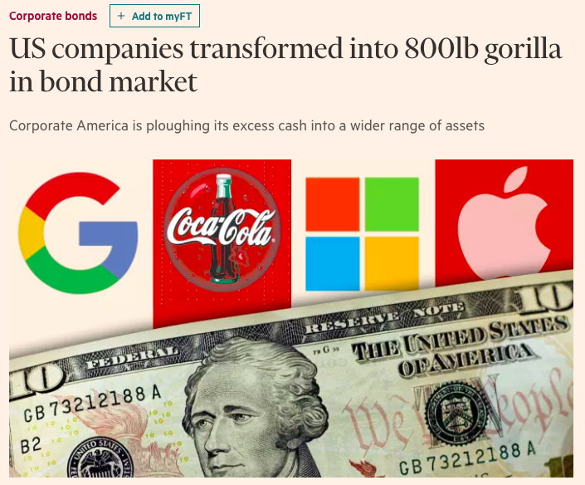
How can we avoid another crisis?
Daniela Gabor

Slide 6





How can we avoid another crisis?
Daniela Gabor

Slide 7
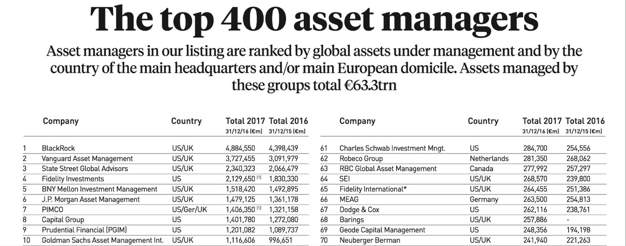
The age of asset management (Haldane 2014), the other side of the demise of the welfare state
How can we avoid another crisis?
Daniela Gabor

Slide 8

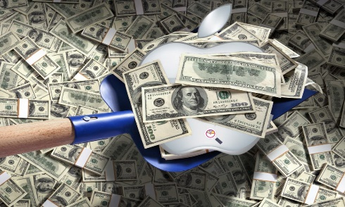




How can we avoid another crisis?
Daniela Gabor

Slide 9
How can we avoid another crisis?
Shortage of safe assets
Public debt solution
Financial innovation solution
Daniela Gabor

Slide 10
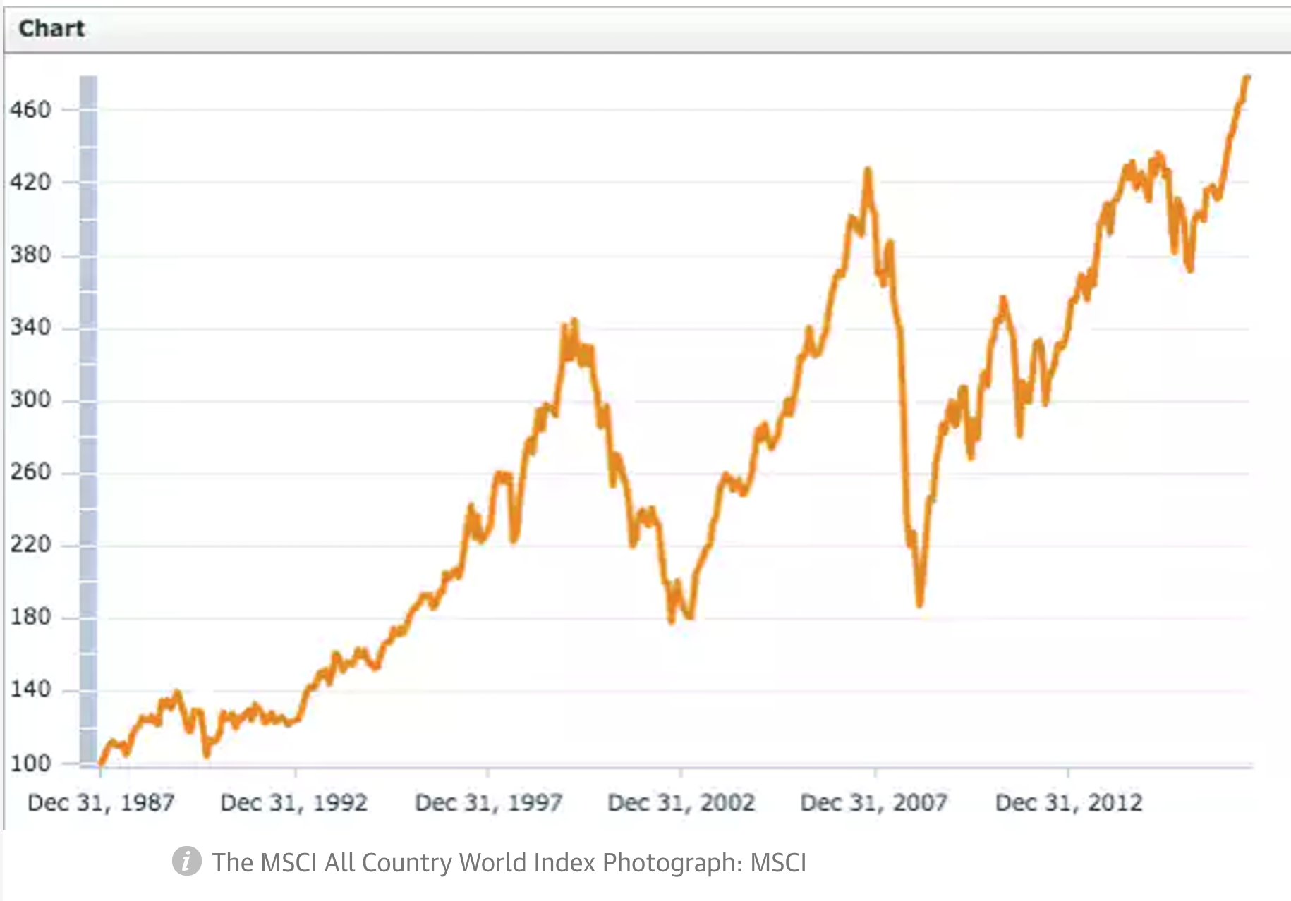
How can we avoid another crisis?
Richard Murphy

