Slide 1
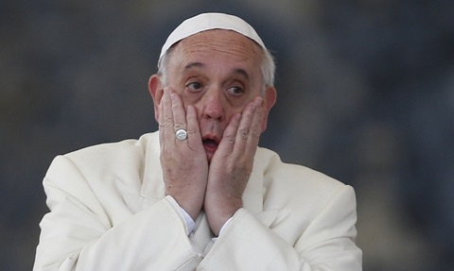
The Global Haven Industry
Progress Report:
- Quantifying Kleptocracy
James S. Henry
Columbia U. Center for Sustainable Investment
Tax Justice Network Research Conference
London
April 21 2016

Slide 2

THE GLOBAL HAVEN INDUSTRY –
Quantifying Kleptocracy
“Panama Papers” context
Quantifying kleptocracy
  Old estimates
  New metrics
So Kleptocracy is a huge growing problem… What’s to be done? Lots…
Notes:
Purpose of today’s presentation: to provide an overview of recent empirical work on several key “pathologies” of tax havens.
-- The number of secrecy jurisdictions has expanded sharply since the 1970s.
-- Now like the “bar scene” in Star Wars: over in this corner, world’s largest companies parking intellectual property; over there, wealthy elites parking
Their financial assets beyond the reach of tax authorities; a dog’s breakfast of drug dealers, kleptocrats, bribe payers and recipients, insider traders,
Manipulators of corrupt privatization deals; major banks seeking to avoiding regulation, etc etc.
-- We’ve long known such abuses existed in general, on a qualitative level…we’ve also had numerous case studies and individual examples.
-- But recently we’ve begun to develop more precise estimates of the overall size and growth of such activities.
-- These estimates not only dramatize the importance of these dubious activities
-- They also help us to identify the key countries and enablers involved in them, and the structure of the overall “haven industry.”
-- That, in turn, should help us design better policy solutions.
-- Here we’ll focus on reviewing recent evidence for four of the most important haven-enabled pathologies:
1. Dubious finance -- Odious debt, odious privatizations, and the “finance curse.”
2. “Pirate Banking” – the placement of private financial wealth beyond the reach of tax Authorities
3. TNC haven abuses – including commodity transfer pricing abuse, intellectual property transfers, and bribery.
4. Global corporate tax competition – the race to the bottom among country corporate tax rates, which even
Has some countries levying negative tax rates – once subsidies and favorable tax rebates and deductions are fully accounted for.
----- Meeting Notes (4/20/16 17:57) -----

Slide 3
Panama Papers context
Largest “leak” in history: rare inside look at the global haven industry
  2.6 Tb, 11.5mm docs (emails, photos, docs)
  All from one Panama law firm, Mossack & Fonseca (“MossFon”)
  214,438 offshore companies →100k from BVI, the rest from 35 other financial secrecy jurisdictions (including Nevada, Wyoming, Delaware
  So far: 22 heads of state, 143 public officials, 61 “inner circles”
  Many crooks…33 folks on trade sanctions lists found so far…much undisclosed wealth
  Sensations: Putin’s best friend; China’s President’s family, Iceland PM:
  Argentina Pres; Ukraine Pres; Lula’s condo; UK PM’s father; etc etc.
  First detailed portrait of the global haven network
  Investigations already launched in 30 countries, including US, UK, Iceland, Neth..
  Source ->Suddeutsche Zeitung→ICIJ, 2015
  ICIJ: 370 journalists in 110+ countries worked in secret on this for a year….
  Spotlight on kleptocracy+ its enablers
  Not an end to kleptocracy…but it is a little harder for them to sleep with the lights on

Slide 4
PP highlights diversity and sheer scale of the global haven industry’s patrons..
Kleptocracy/bribery/corruption
Dirty money/ money laundering for org crime
Pirate banking (tax dodging for wealthy elites)
Fraud (financial, art)
Insider trading schemes
MNC/ big bank misconduct
Sanctions busting, arms dealing
“Representation W/O Taxation” –
  Disproportionate pol purchased by the global haven industry
  “Bespoke laws”

Slide 5

…like the Star Wars’ bar scene:
Diverse miscreants sharing same facilities to protect and enjoy
their ill-gotten gains:
  Financial secrecy
  Weak regulation, taxation
  Professional “enablers”
  (Ironically): access to protection of the rule of law, independent courts,
  and “too big to fail/jail” financial institutions!

Slide 6
PP highlights myths about havens
“News”
  Actually a very old old story
  The “banality of exposes…”
“Tax Havens”
  Kleptocracy> tax for many countries
  Many other pathologies
“Individual havens”
“Offshore””
  Actually a huge global network – mostly onshore
  Credit Suisse/ Lenz & Staehelin example
“Legal”
  “ 95% of our clients” – many other examples
  Laws as sausages
  What’s “legal,” where and when? Slavery…child labor…women’s rights
“US is largest haven”
“Modest size” / “enablers under control”

Slide 7
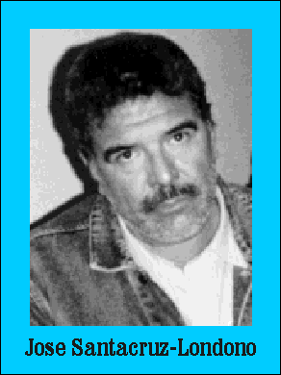
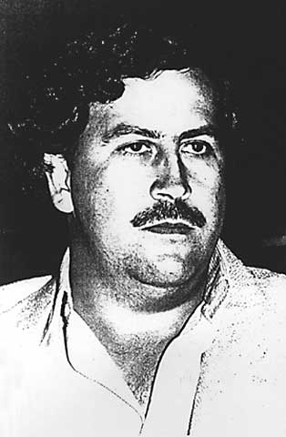
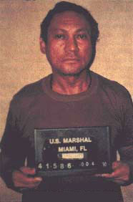
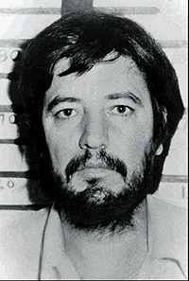
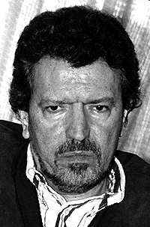
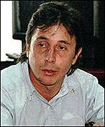
An old story….I first encountered MossFon in Paname in 1987, while investigating Noriega for a book…

Slide 8
BTW…yeah, that sure worked well…(decartelization):
US Average Retail Cocaine Prices Vs. % Current Users, 1981-2002

Slide 9
Mossack & Fonseca
Founded in 1977 by Jurgen Mossack (German émigré), Panama City
Strong growth under “the Generals” (Torrijos/ Noriega) until June 1987
Already serving UBS at that point
Panama’s haven suffered, late 1980s → diversification, globalization
Leveraged by the rise of the global haven industry
2015: $42 mm revenues, 500 staff in 35 countries (300 in Panama)
Core biz: off the shelf conduit (“letterbox,” “shell”) companies, foundations, and trusts
  Global clientele: 200 countries,, 13.5k other intermediaries (mainly lawyers and accounting firms)
  World’s largest banks are core clients
    HSBC: >2600 companies;
    Credit Suisse:> 1200
    UBS: 1100+
    16 German banks – 00s of companies
  143 pubic officials, 22 heads of state, 61 insider groups – so far
  Part of a global network: not calling on Putin + Xi by itself

Slide 10
After 40 years, a little tired of “the global underground economy”
1966 - $1/hr making pizzas in Minnesota
1976 - “Calling in the Big Bills” – demand for US currency
1978-81 – Sequels to CBB, Fed Res data, Castle Bank
1983 - My Amer Bar Association book on Income Tax compliance
1984 – Film on Honduran land reform
1986 - “Debt Hoax” - relation between debt and flight
1987-90 -Noriega, Marcos, Stroessner, Brazil, Tiananmen Sq.
1992 – Brazilian Supreme Ct judge
1996 - “Banqueros y Lavadolares” – first book on int’l tax havens
2003 - “Blood Bankers” (Basic Books) – odious debt book
2005 - “Banking for the Poor” (WBk)
2006 – Doc film about Evo Morales: “Cocalero”
2007 – “A Game as Old as Empire” – study of debt relief
2009 – Oxfam GB study for G20 – offshore haven estimates
2010 – Estimates of untaxed offshore wealth (Forbes)
2012/13 Doc film: “We’re Not Broke” (Sundance FF)
  “ The Price of Offshore Revisited” (TJN): flurry of interest in my original estimates
2014 Doc film: “The Price We Pay.” (Toronto FF)
2015 Haiti Remittance Project – Col U., -- first project to address human capital flight
Credit Suisse hearings – DOL
“Enablers” – NUPI – Argentina/ RSA/ Switzerland: case studies of capital flight enablers in 3 key countries
2016
  “Let’s Make the Vatican Bank a Bank”
  Long essay in Global Tax Fairness (Pogge & Mehta, ed, Oxford U Press, 4/2016).
  Panama Papers
  TJN estimates update
2017 Pirate Bankers (Col. U.: 2017)

Slide 11
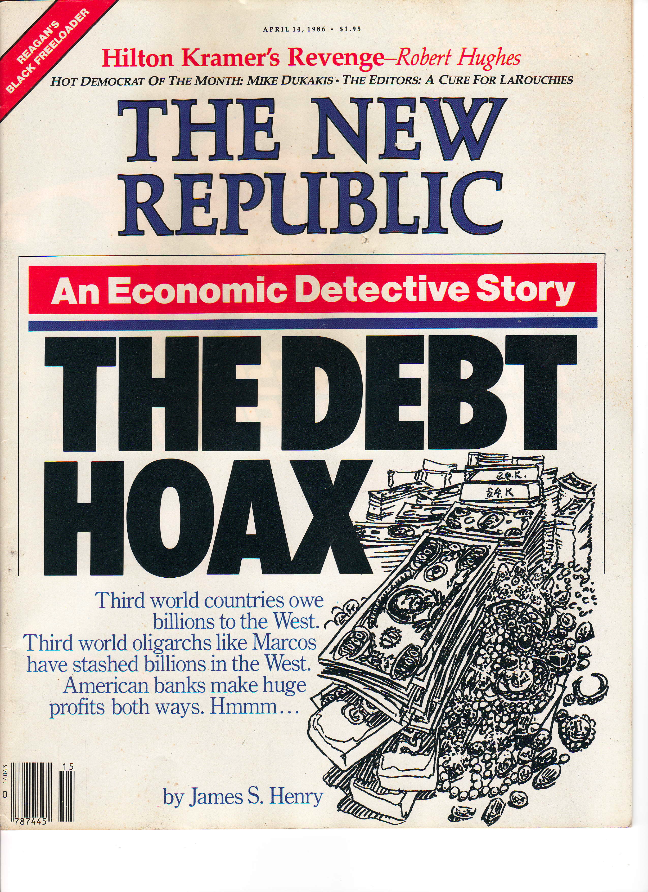
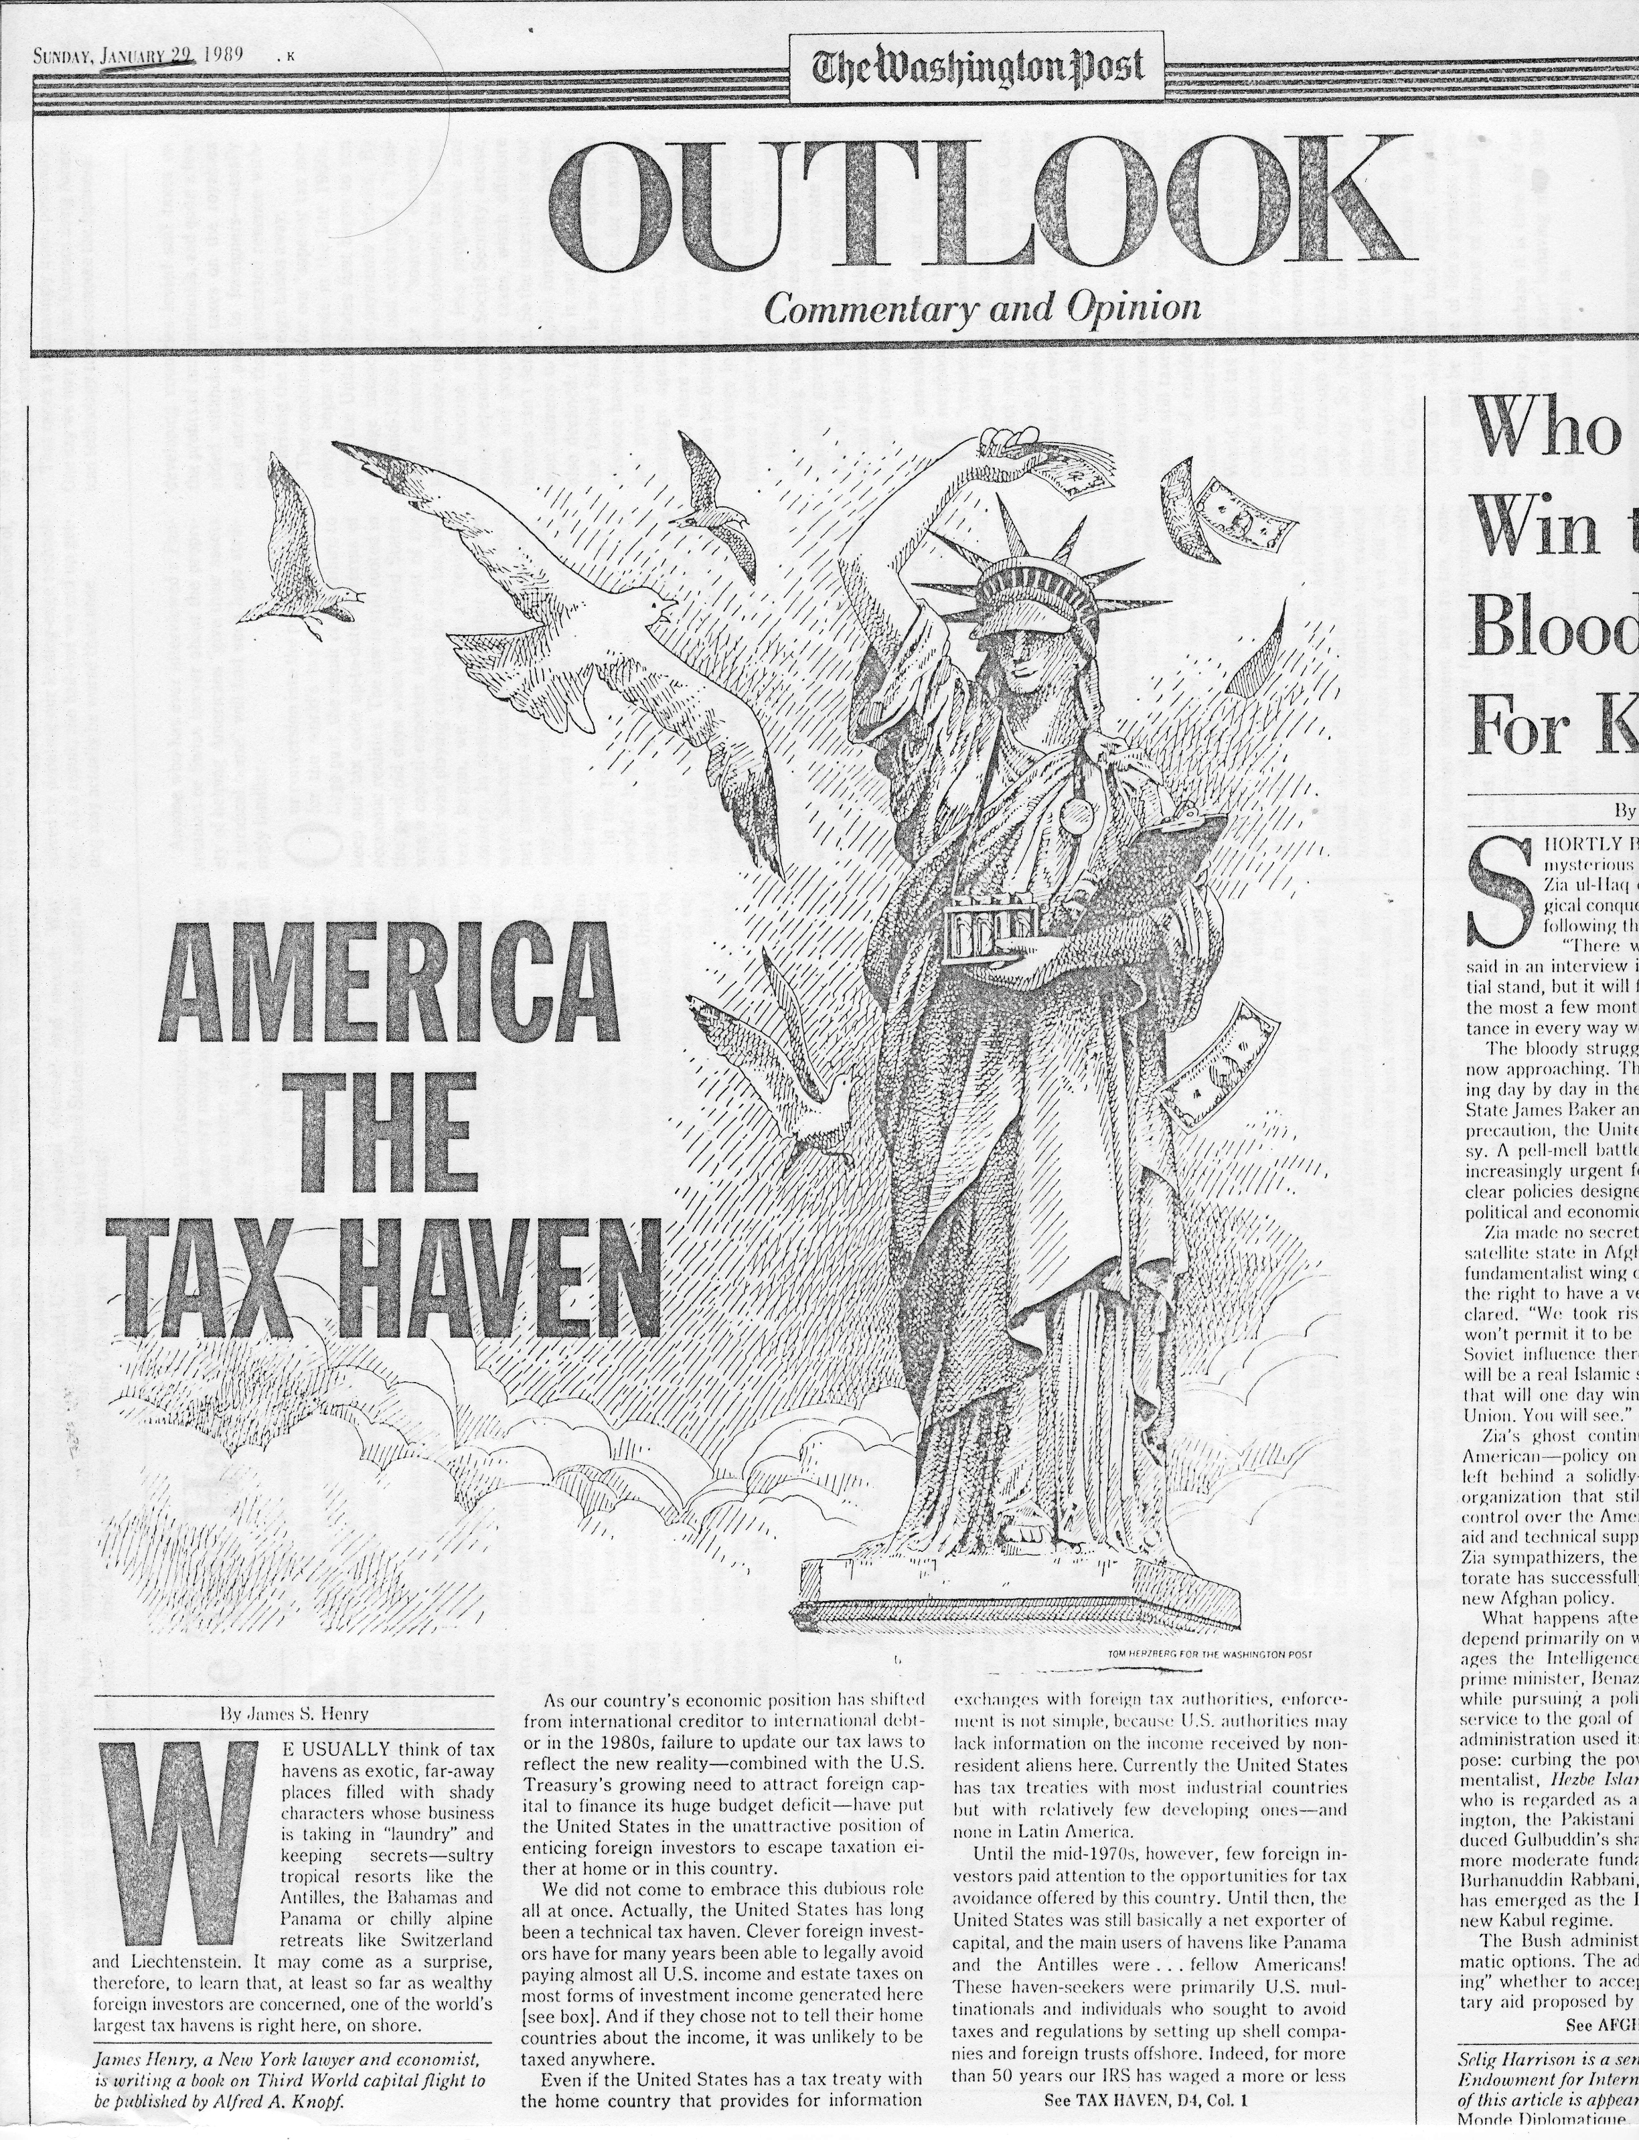

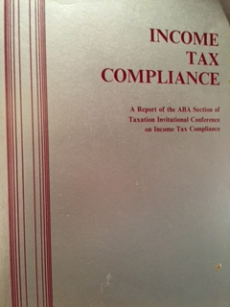
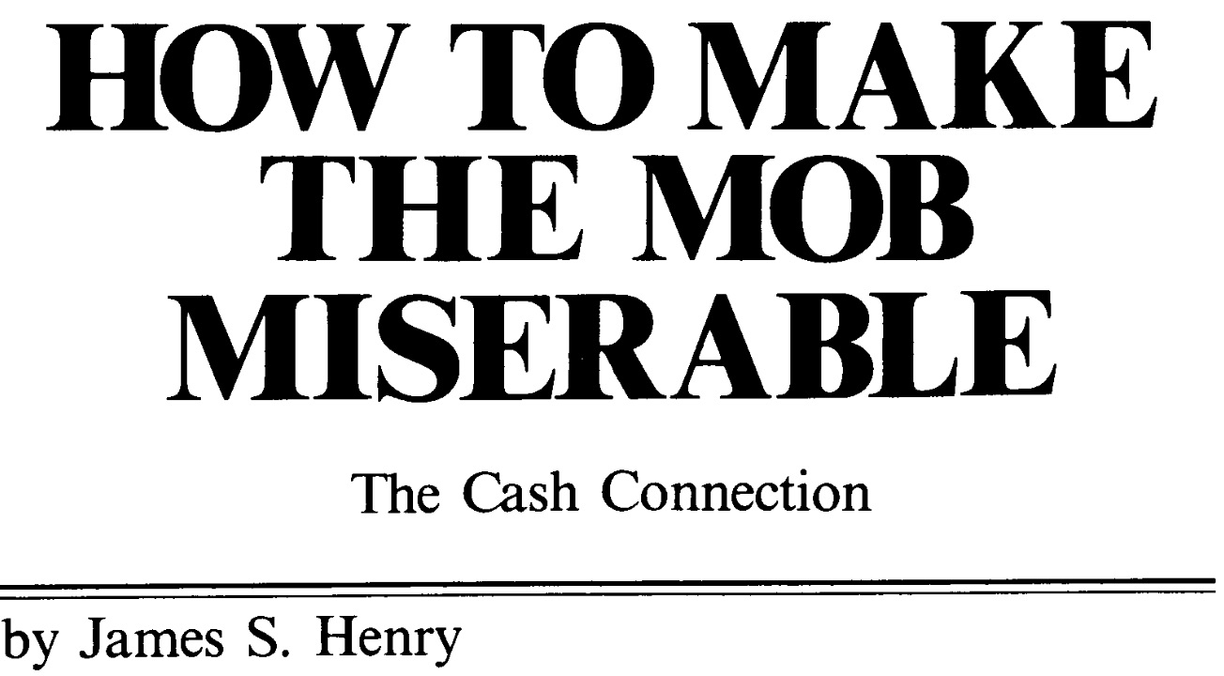
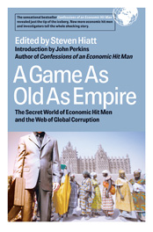
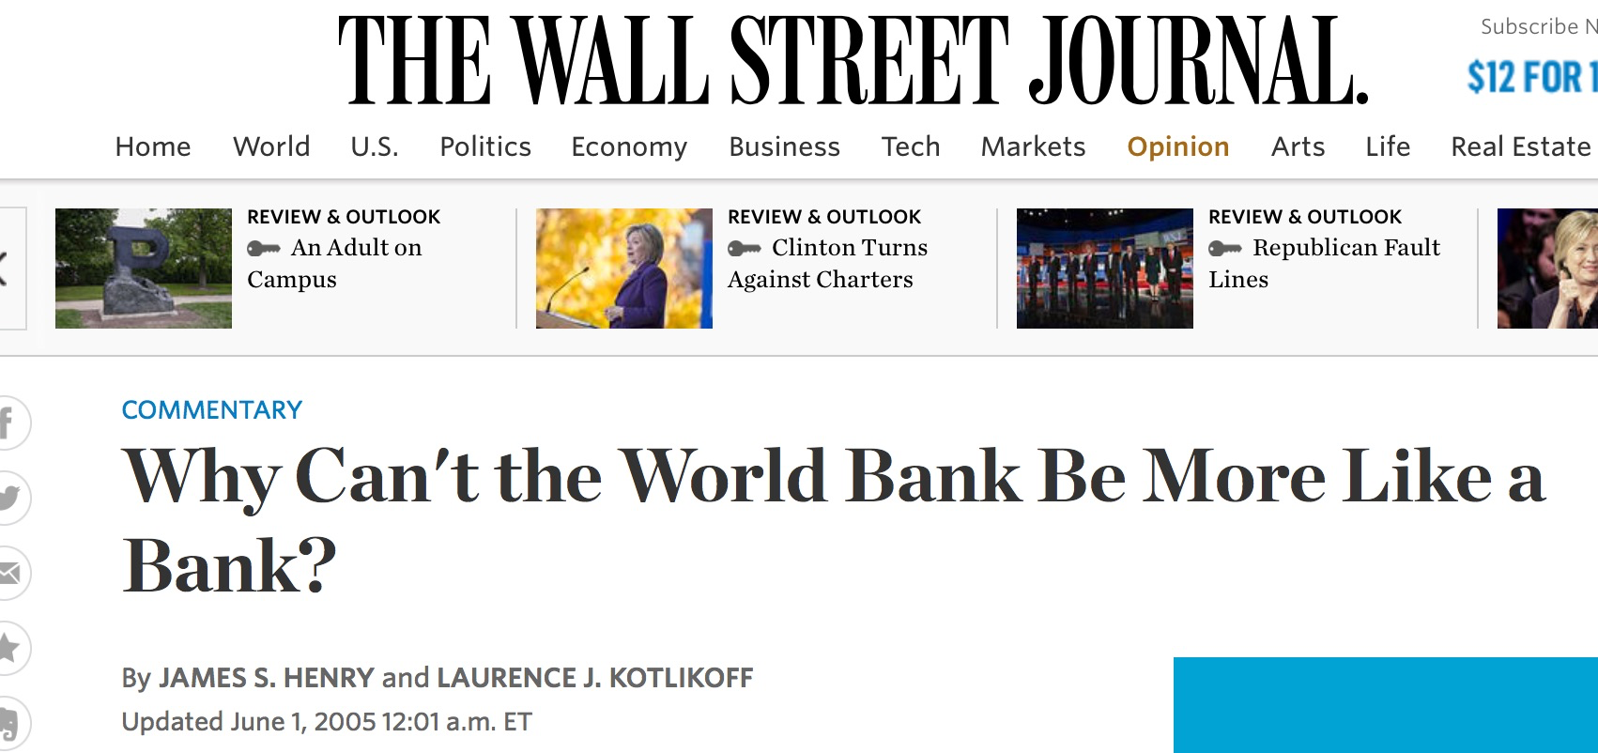
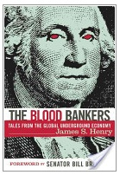

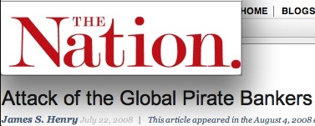
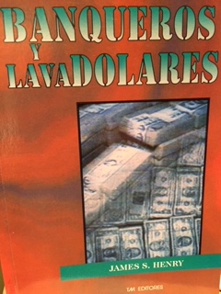
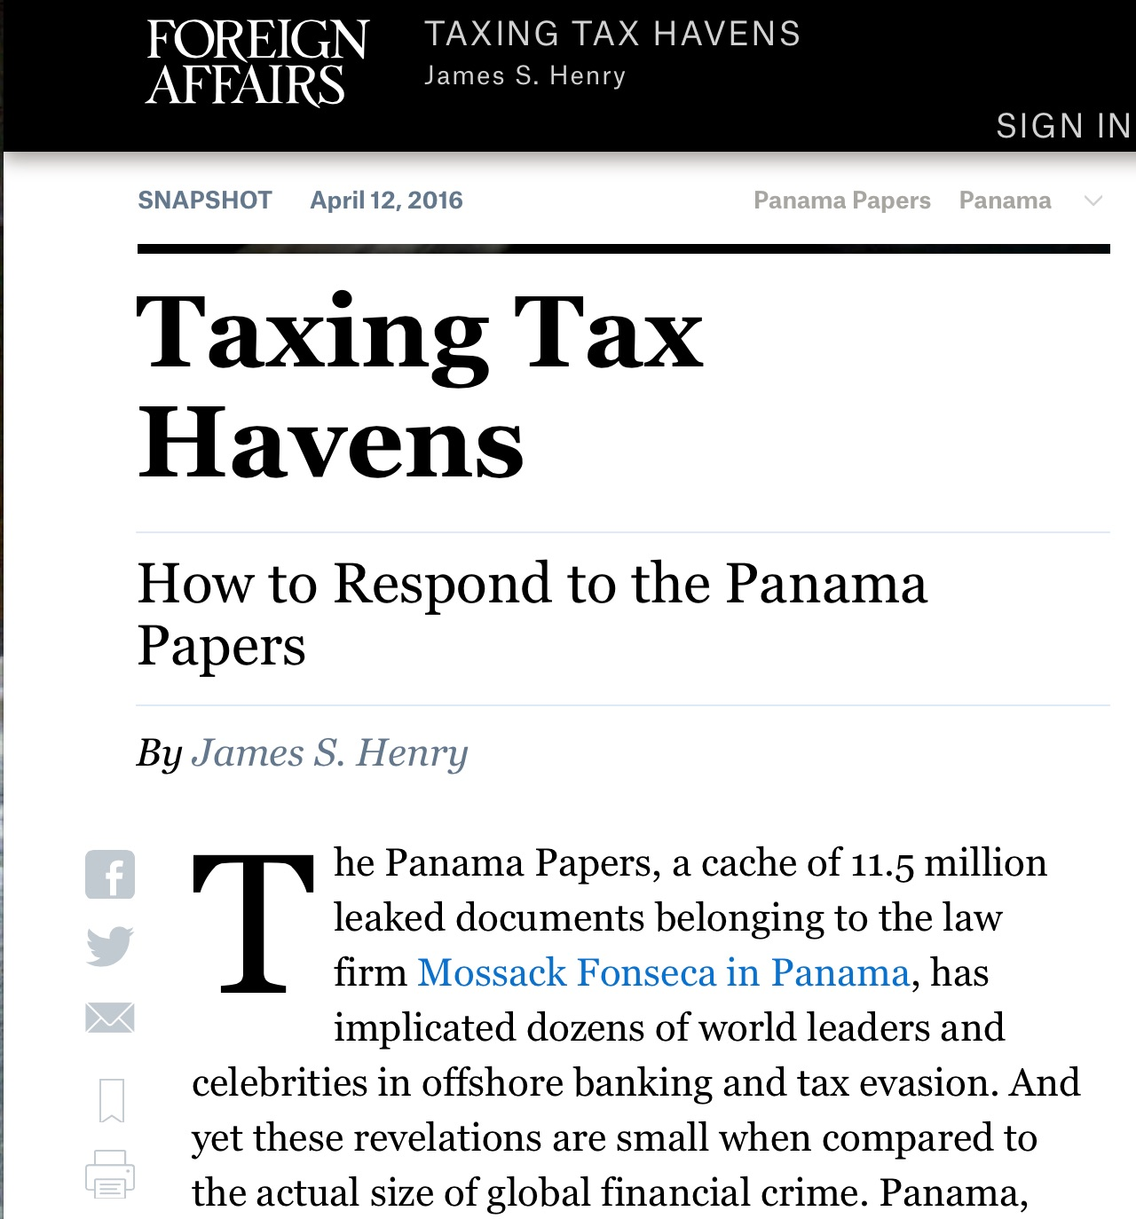




Slide 12
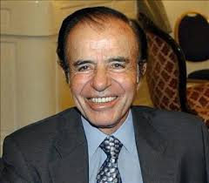

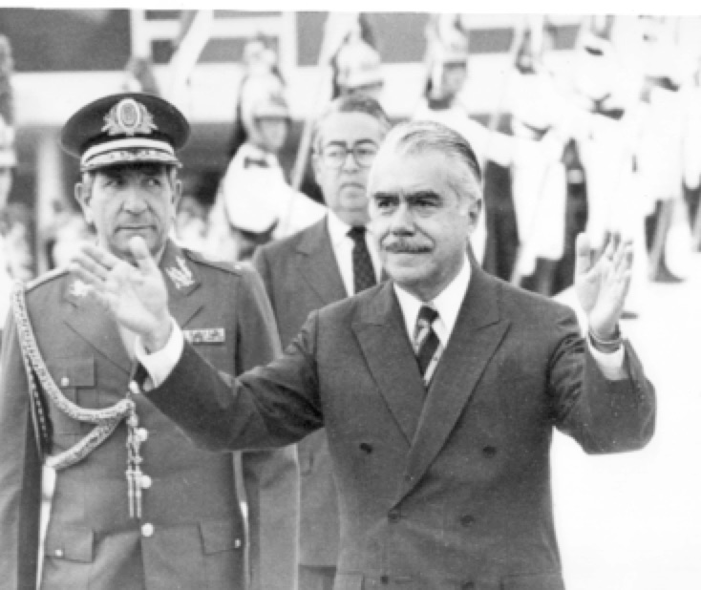
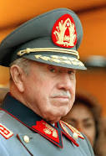
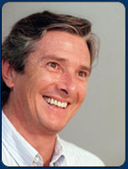
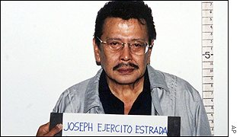
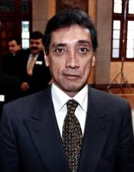
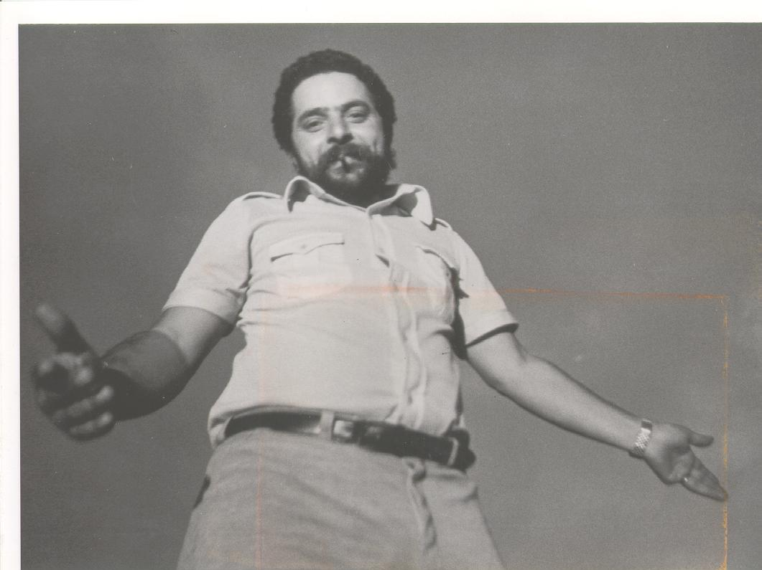

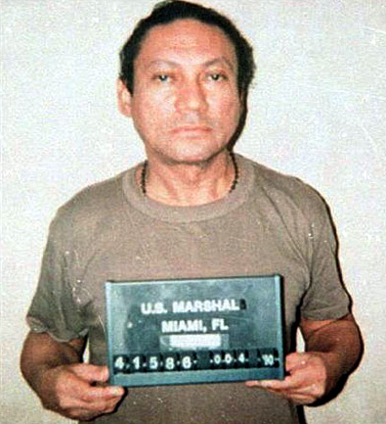
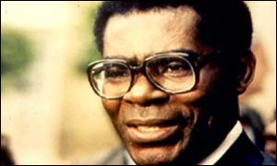
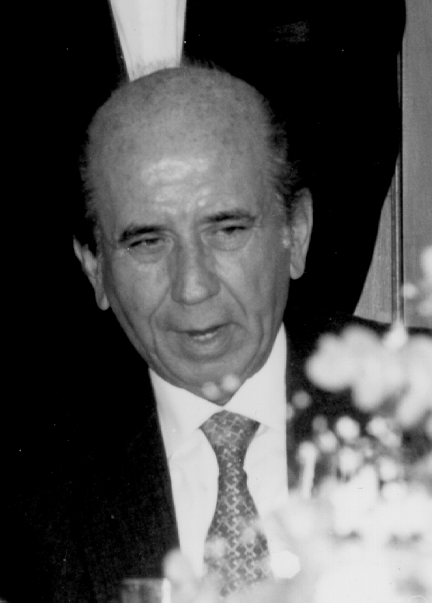
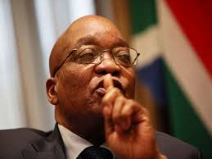
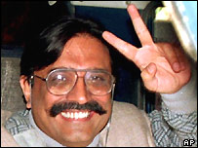
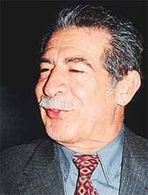
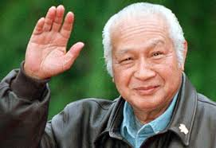
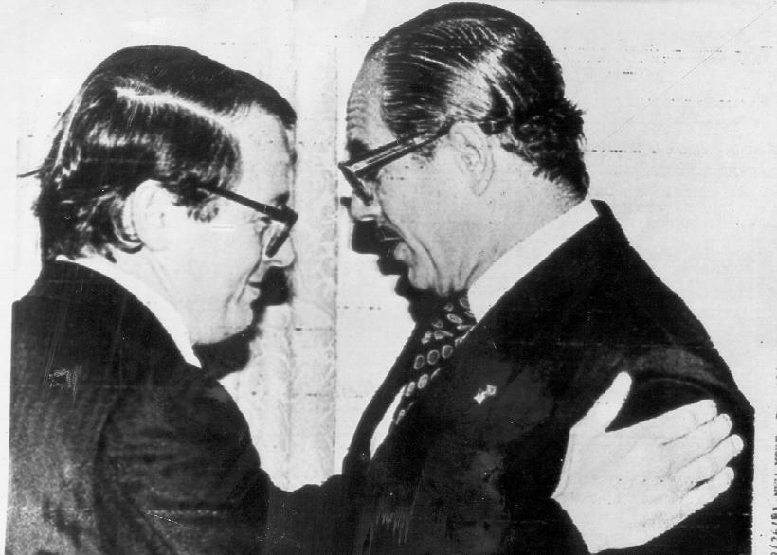
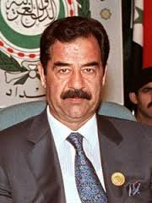

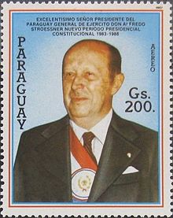
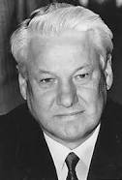
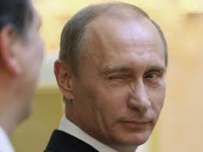
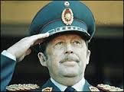
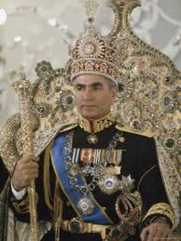
“Kleptocrats I Have Known (Or Investigated..)”

Slide 13
Odious Debt Investigations
Argentina: Citibank,Santander
Bolivia: gas&water
Brazil: JPMorgan
Chile: BT/DB - privatization fiasco
Ecuador: bond diversions
Haiti/ West Africa: BNP SocGen
Mexico: Citibank/BankAmerica/ Pemex union
Guatemala: WBk loans/ genocide
Nicaragua: BT/DB – Sandinistas
Panama: BNP/Noriega
Paraguay: Citi/Stroessner
Venezuela: Chase/ CAP
Iran: Chase/HSBC/Shah/hmandinejad
Iraq: Deutsche Bank
Angola: Port banks/ oil diversions
Nigeria: HSBC, Barclays, etc
South Africa: Barclays/ HSBC/DB
Indonesia: HSBC/ Austrian banks
Philippines: UBS/ Marcos

Slide 14
The latest klepto…an old friend…

Slide 15
Quantifying Kleptocracy
Our old estimates
  Why we bother with quantification
  Early efforts
  2012: 3 methods
  Capital flight flows vs. flight wealth
Latest estimates

Slide 16
Investigative economics
Investigative Economics | Neoclassical Economics
“Just look at the f’in data.” (J. Tukey’s inter-ocular significance test) | Optimization model-centric
Anomaly-driven: Puzzles tell us where to look (often with night vision) | Models tell us where to look
Skeptical of “methodological individualism” | Bias toward “methodological individualism”
Plausibility counts: case based + inferential | 19^{th-}century positivism lives on: “prediction” trumps “explanation”
If you want to know how someone feels, you can ask them | 1960s behaviorism: “You look pretty good today; how am I?”
Get out of the armchair, go to the field ( vs. “abstract empiricism”) (C. Wright Mills) | “But I want tenure!… and my armchair is very comfortable!”

Slide 17
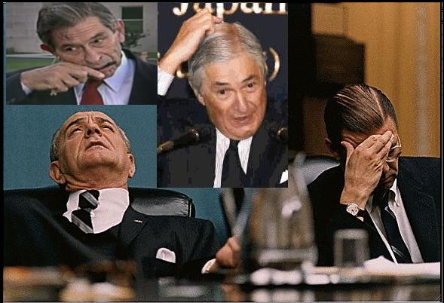
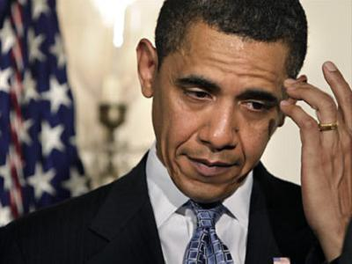
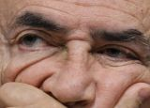
If you cannot express it in numbers, your knowledge is of a meager and
unsatisfactory kind.
-- Lord Kelvin, 1889
Notes:
One critical strategic choice by TJN – the value of developing new metrics in this arena
-- to provide a lightning rod for policy debates/ dramatize importance
-- to understand industry structure
-- to design better policy
Examples: offshore industry estimates; transfer pricing abuse estimates; intellectual property abuse case studies; secrecy jurisdiction index
Precise quantification of relative importance of different havens.

Slide 18
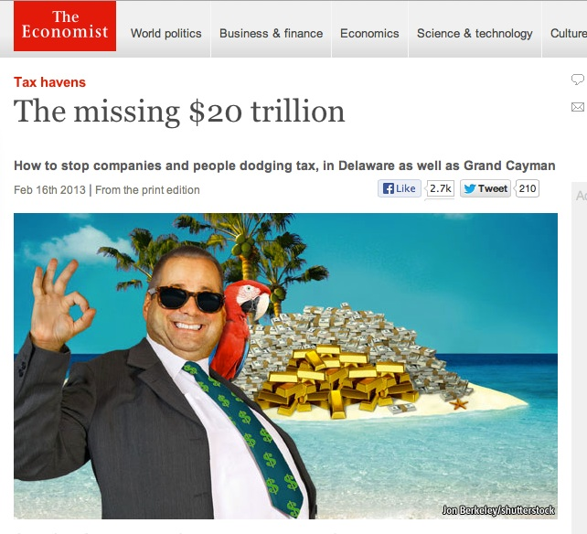

Slide 19
Pirate Banking – huge global biz: help kleptos and private elites put wealth offshore, manage it remotely
Notes:
Another key neoliberal pathology of the global haven industry -- pirate banking: world’s largest banks
Made it their most profitable business…: moving money offshore to dodge taxes, protect private wealth
Of the world’s richest people from the state / pol risks/ creditors/ spouses/ partners, etc…comingled with
Criminal $, corruption $, etc…

Slide 20
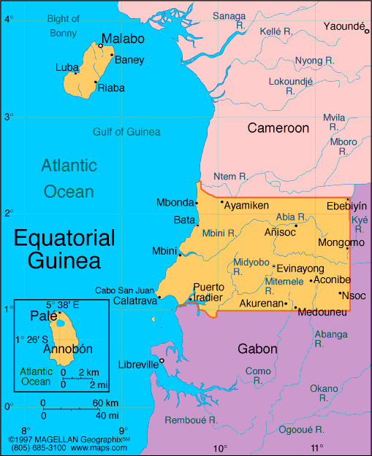
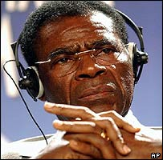
Our first estimates of “flight wealth” (2005) for Eq Guinea’s dictator
Brig. Gen. (ret.) Teodoro Obiang Nguema Mbasago
  Age 63
  Member, Mongoma-based Esangui subclan of “Fang” tribe
  His family has ruled EG since 1968
  $700+million in Riggs National Bank (DC), by way of Exxon-Mobil, Amerada Hess, Marathon Oil)
  Other US, Swiss, French bank accounts

Slide 21
Equatorial Guinea - Private “Flight Wealth” vs. Country Debt, 1985-2003 ($MM)
Source: World Bank, IMF data (2005), JSH analysis

Slide 22
Global Flight Capital Wealth -- Key Countries, 2004**
(Current $Billions)
= $2,968.5 B
**Including misinvoicing adjustment
Source: data from IMF (2005), World Bank (2005); JSH analysis

Slide 23
Feb 1989
July 2012

Slide 24
Triangulating on the offshore hole in the global economy….
Unrecorded Capital Flows and Stocks
( 139/ 154 developing countries)
Cross-Border
Portfolio Model
(BIS data/ PB interviews)
Private Bank AUMs
(world’s top 50 PBs)
Notes:
How large? Like estimating size of black hope
-- Dearth of serious work on this subject from official institutions
-- long history of “capital flight estimates” –JSH and Boyce did original estimates for dev countries in 1980s…
-- Recent 2012 study for TJN estimated size and growth from three directions…
-- independent estimation methods: but consistent results
Detailed models of unrecorded capital outflows and accumulated offshore wealth for 139 key source countries
Cross border portfolio model – based on Bank for International Settlements data on cross border deposits by nonbanks.
…BIS doesn’t reveal full matrix, but enough to say what total offshore portfolios might be worth, given our knowledge of
Typical investor behavior wrt ratios of deposits to total net worth
3. Detailed look at top 50 players in international private banking: both managed + unmanaged assets (deposits plus brokerage custody assets) as of 12/2010

Slide 25
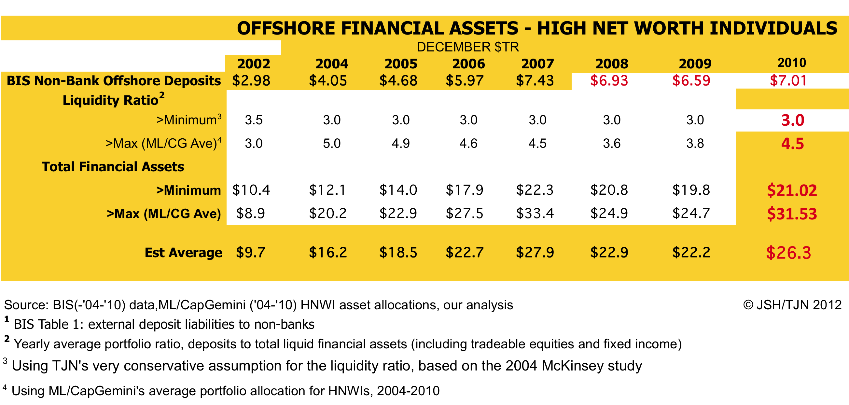
Notes:
Second indicator – portfolio model using BIS data
-- Still no detailed country-by-country matrix of BIS deposits
-- BIS has only said two things in response: 1. more data will be published in 2014
2. “We depend for the data on vol cooperation of 30 financial centers”
We should demand more details – at least on historical data
-- Scale up factors based on interview with private bankers about typical portfolios…as well as data published by
Banks, researchers on portfolio multiples.
-- One reason this is conservative: leaves out non-financial wealth (huge amount of real estate, yachts, art, etc held via offshore vehicles – another $10 trillion…

Slide 26
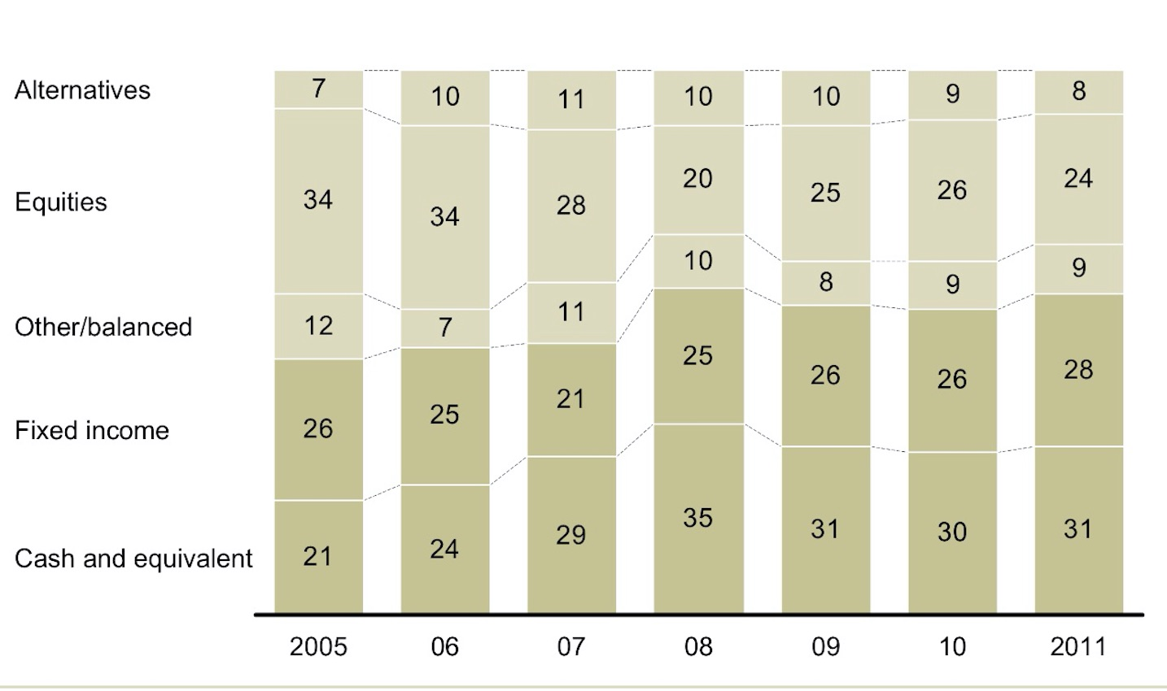
Example: W Europe UHNW Private Banking Clients
Portfolio Composition, 2005-
Source: McKinsey & Co. (2012)

Slide 27
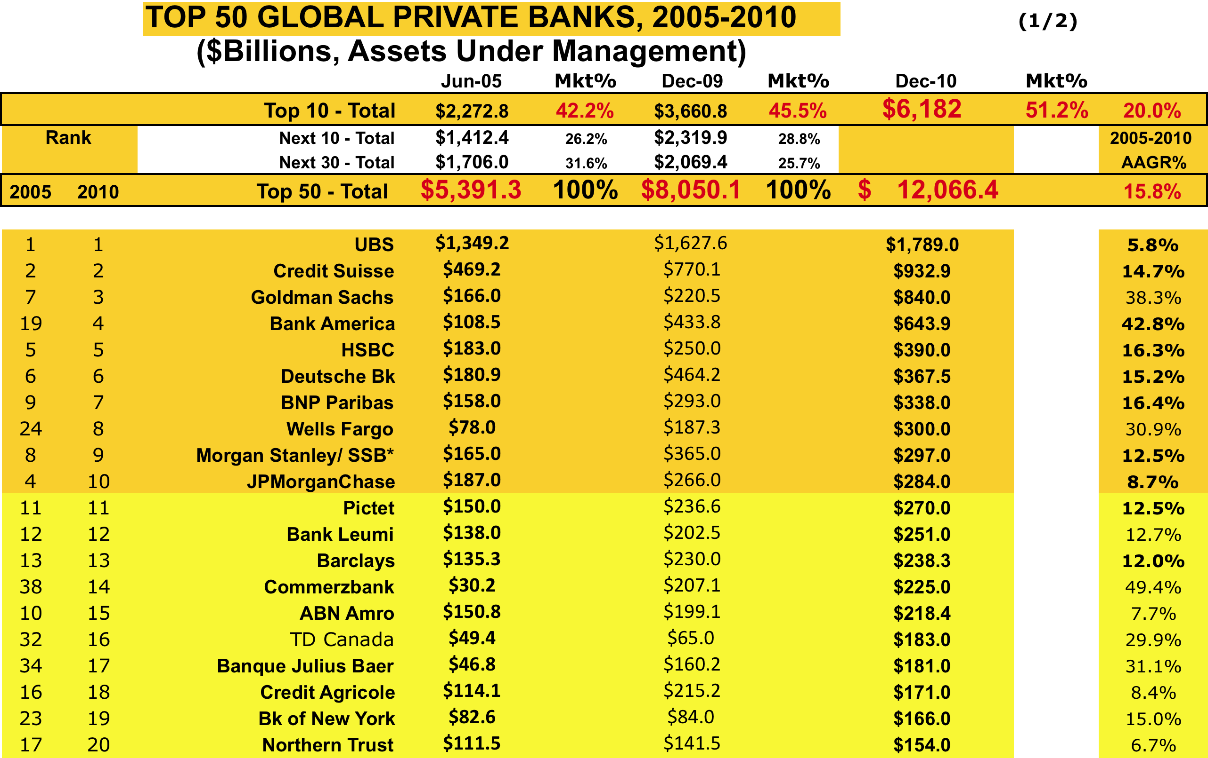
Source: bank financials, private banking industry interviews, JSH analysis
Notes:
Top 50 intl banks -- $12.2 trillion of managed plus unmanaged HNW private financial assets as of 12/2010
-- top 20 are familiar; same banks as in 3W debt crisis, 2008 financial crisis, bailouts, Libor rigging, etc etc.: serial offenders
-- top 10 control half
-- policy implication: get a handle these folks, you’ve made some progress
-- withholding tax on these assets (1% p.a.) enough to finance all ODA debt…

Slide 28
Top 22 Global Private Banks –
Incidence of Corporate Crime, 1998-2015
Source: Internet/ lit search, JSH analysis

Slide 29
Traditional Flight Capital Estimation Process -
Russia Example
 | Debt Flows ($B) | Net Foreign Investment ($B) | Total Sources ($B) | Reported CA Deficit | Ch in Reserves | Total Observed Uses | Annual CF Estimate ($B current) | Annual CF Estimate ($B US 95)
1994 | 9.8 | 0.4 | 10.3 | 7.8 | 3.4 | 11.3 | 21.6 | 22.0
1995 | -.3 | 1.5 | 1.1 | 6.9 | -4.9 | 2.1 | 3.2 | 3.2
1996 | 4.9 | 3.7 | 8.7 | 10.8 | 6.1 | 16.9 | 25.6 | 25.1
1997 | 1.2 | 3.0 | 4.2 | -0.1 | -0.4 | -0.5 | 3.7 | 3.6
1998 | 50.2 | 2.2 | 52.4 | 0.2 | 10.5 | 10.7 | 63.2 | 60.0
1999 | -3.1 | 0.8 | -2.3 | 24.6 | -5.4 | 19.2 | 17.0 | 15.9
2000 | -14.7 | -0.4 | -15.1 | 46.8 | -18.9 | 27.9 | 12.8 | 11.8
2001 | -7.5 | 0.7 | -6.8 | 33.8 | -12.0 | 21.8 | 14.9 | 13.4
2002 | -4.9 | 2.6 | -2.3 | 29.1 | -12.8 | 16.3 | 14.0 | 12.4
Total |  |  |  |  |  |  | 175.9 | 167.3
Source: data from IMF (2005), World Bank (2005); JSH analysis

Slide 30
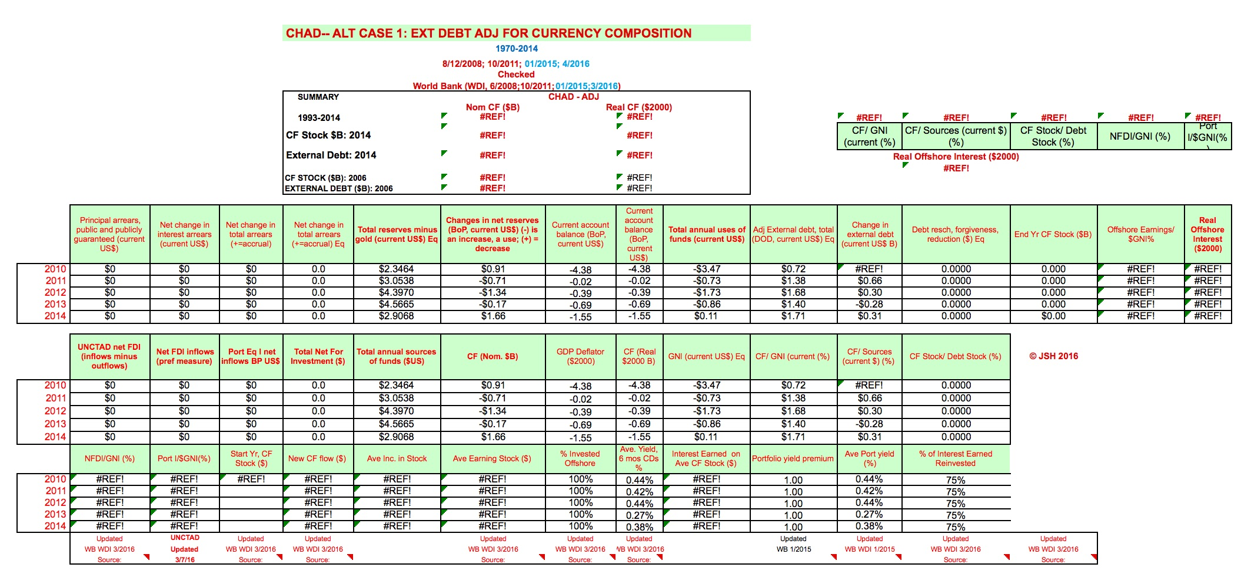
Our flight wealth model basically takes account of the fact that most flight is
reinvested and accumulates offshore, tax free.

Slide 31
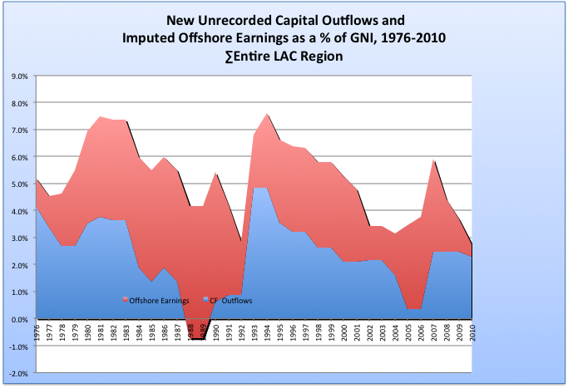
Source: Project data models, JSH analysis
Notes:
This chart highlights IMPORTANCE OF THE UNREPORTED OFFSHORE EARNINGS estimates allowed by the STOCKS method.
-- EVEN AFTER initial flows dry up, offshore wealth can continue to grow because of these retained earnings.
-- So eg LATIN AMERICA STILL HAS A FLIGHT CAPITAL PROBLEM, though new flight has been reduced…

Slide 32
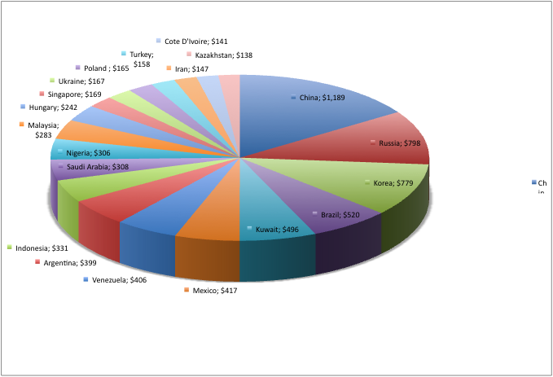
Our original 2012 paper estimated global flight wealth from 139 countries
in developing regions at $9.4 trillion.
139 countries = $ 9.4 Trillion
Top 20 = $ 7.6 Trillion
Global Flight Wealth -
Key Countries, Including China
($2010 Billions)

Slide 33
Quantifying Kleptocracy
Our old estimates
Latest estimates
  139 countries: models of cap flight 1970-2014
  2010 estimates updated to 2014 (YE)
  2010 estimates re-estimated using latest data on comparable basis
  Latest data as of 4/29/2014 from IMF, World Bank, UN, Central banks
  >1500 person hours plus peer reviewed by economists with long experience in capital flight estimation

Slide 34
Quantifying Kleptocracy
Our old estimates
Latest estimates – key findings
  $2014 offshore wealth total from developing (non-US/Canada/W.Europe) regions: $12.1 trillion.
  Strong growth, especially for kleptocratic regions: $12.1 trillion, vs $9 trillion in 2010.
  Bottom 75% of countries by $PPP-adjusted per cap Y: 64% of total, or $7.6 trillion
  Top 30 countries are dominated by autocratic, corruption ridden kleptocracies: 94% of total
  Developing regions as a whole are “net lenders” of $12 trillion, after netting flight wealth and official reserves from gross external debt – invested mainly in low-yield assets, this represents a HUGE opp cost – worth much more than lost taxes
  Piketty/Zucman (2014) are missing a lot of offshore wealth
  Focus is on developing regions global total is now $24-$34 tr of private financial offshore wealth (vs $21-$32 tr in 2010)

Slide 35

DEVELOPING REGIONS: SIZE AND GROWTH OF
OFFSHORE WEALTH BY KEY REGION, 2010-14
(Nominal $B).
**
∑= $12,101
RAAGR%
6.7%
∑= $8,989
7.9%
6.9%
5.7%
3.7%
3.1%
2010
2014
Source: IMF/WB/ Central bank data, Flight wealth model, my analysis

Slide 36

DEVELOPING REGIONS: SIZE AND GROWTH OF
OFFSHORE WEALTH BY SOURCE COUNTRY
INCOME LEVEL, 2010-14
(Nominal $B).
2010
2014

Slide 37


Slide 38


Slide 39


Slide 40


Slide 41


Slide 42


Slide 43


Slide 44


Slide 45

Another huge hidden cost of the
“offshore” haven industry….

Slide 46
Again, an old story….from my 2005 pres. Since then it has gotten worse..
Global Flight Wealth
Vs. Global Developing Country Debt
(1980-2003)
(Billions US $Current)
Source: data from IMF (2005), World Bank (2005); JSH analysis

Slide 47
…And oh, btw: our global total has also increased, to $24-$34 trillion…
Preliminary
CROSSBORDER
CASH PLUS DEPOSITS
Source: BIS (2014) data, JSH analysis

Slide 48

This is about 10-15% of global financial wealth…as in 2010.
Global financial wealth: $54 trillion 1990; $212 trillion 2010…
$240 trillion by 2014…
Source: Mckinsey & Co. (2011); my analysis

Slide 49

“It is capitalism that is truly radical.”
-- Brecht
.

Slide 50


Slide 51
We need a new focus on kleptocracy as well as tax justice
Importance:
  Developed countries spend/ tax 25-40 % of GDP
  Case for strong democratic states
  No cases of sustained development w/o it
  Globalization makes weak states weaker
$12.5 tr. global gov spending (93% tax financed)
    If 5% is stolen, same size as tax dodging
    Echo effect: if gov widely viewed as a ”thief” → cuts tax compliance
Theories
  Conventional: ”indigenous” factors (culture, dom institutions)
  Alternatives: colonial legacy; global enablers

Slide 52
Kleptocracy – Hypotheses
Strong relationship between autocracy and corruption
Not just a product of indigenous institutions…key role of enablers
  State capture
  Global haven services
  ”Manufacturing consent” – defending the ”higher immorality”
Low support for tax justice in many countries → state widely perceived as a thief
No successful examples of development without a strong state…and strong states emerge by transcending kleptocracy
Globalization makes weak states even weaker
Notes:
Another form of TNC abuse that uses havens – parking of intellectual property in offshore havens, payment of “royalties” based
On inflated valuations of offshore property, leading to low taxes on world’s largest tech companies.
Apple example – china gets $800 mm / $10 billion retail value, rest is largely tax free because intelletual prop has been parked offshore

Slide 53
Implication: Need to combat BOTH kleptocracy + tax injustice
In many countries the state is perceived as a thief
Given relative low yields on offshore investments , even if all taxes were collected, net rev gain to home country is less than if offshore K is reinvested back home at much higher yields
Strategy: Tax on anonymous wealth plus increased enforcement, reduced secrecy, increased investor protections can help to drive offshore funds into the above-ground economy

Slide 54
Tackling Kleptocracy:
Much Can Be Done (Assuming Political Will)
  Tougher penalties for enablers
  (lawyers, bankers, accountants)
  Specific tougher regulation of international private banking
  Global wealth tax on anonymous wealth
  Big bills recall
  Increased transparency
    Public official wealth declarations
    Ben ownership registration
    Auto info exchange
    CxC reporting
    “Publish what you pay”
  Coordinated Guatemala-type investigative commissions with subpoena powers
  Increased law enforcement resources
  More resources for Intl research on global haven industry
  Increased whistleblower/ journalist protection

Slide 55
Spain’s “Special Role” in €500 Notes
(€Billions,2002-2013)
May 1976
These things sometimes take a long time…But don’t give up!
Next week the ECB will finally withdraw E500 notes…and Larry Summers
has discovered $100 bills
Bank de Espana sourced 26.7% of all
net outstanding €500 notes, 2002-07
Source: ECB (2013) and Banco de Espana (2013), data; my analysis

Slide 56
Merci!

